Slide 1
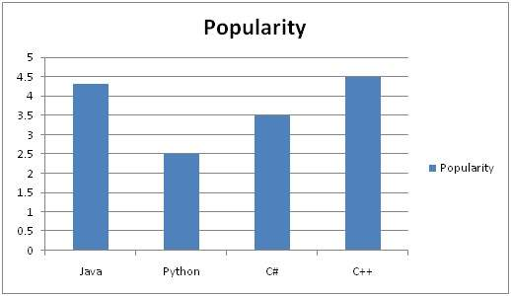
Image Enhancement – Histogram Processing
Histograms
A histogram is a graph. A graph that shows frequency of anything. Usually histogram have bars that represent frequency of occurring of data in the whole data set.

Slide 2
Histogram of an Image
Histogram of an image, like other histograms also shows frequency. But an image histogram, shows frequency of pixels intensity values. In an image histogram, the x axis shows the gray level intensities and the y axis shows the frequency of these intensities.

Slide 3
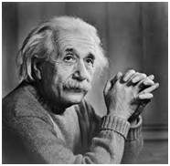
Example
The histogram of the above picture of the Einstein would be something like this

Slide 4
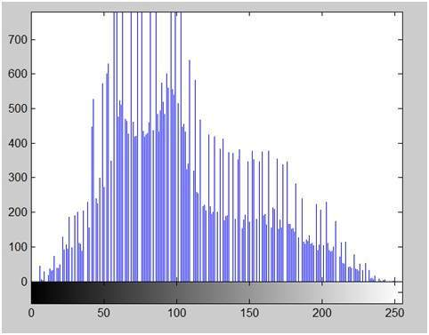
The histogram of the above picture of the Einstein would be something like this

Slide 5
The x axis of the histogram shows the range of pixel values. Since its an 8 bpp image, that means it has 256 levels of gray or shades of gray in it. That’s why the range of x axis starts from 0 and end at 255 with a gap of 50. Whereas on the y axis, is the count of these intensities.
As you can see from the graph, that most of the bars that have high frequency lies in the first half portion which is the darker portion. That means that the image we have got is darker. And this can be proved from the image too.

Slide 6
Applications of Histograms
Medical Imaging: Enhancing details in X-rays (like fractures or tumors) and MRIs (brain structures) where subtle intensity differences are crucial.
Satellite & Aerial Imaging: Improving visibility of terrain, roads, or features in cloudy or poorly lit satellite photos.

Slide 7
Biometrics: Sharpening facial or iris images for better feature extraction in recognition systems.
Computer Vision: Pre-processing images to improve object detection, recognition, and segmentation by making features more distinct.
Scanned Documents: Clarifying text and images in old or poorly scanned documents.
Astronomy: Revealing faint details in celestial objects.

Slide 8
Histogram Equalization
It is used to improve contrast in images.
It accomplishes this by effectively spreading out the most frequent intensity values, i.e. stretching out the intensity range of the image.

Slide 9
